Slide 1
Stock analyze

Slide 2
Table of contents
01
02
03
04
05
06
Dataset overview
RSI
MACD
ATR
PLOT
TOP 10

Slide 3

01
Dataset overview

Slide 4
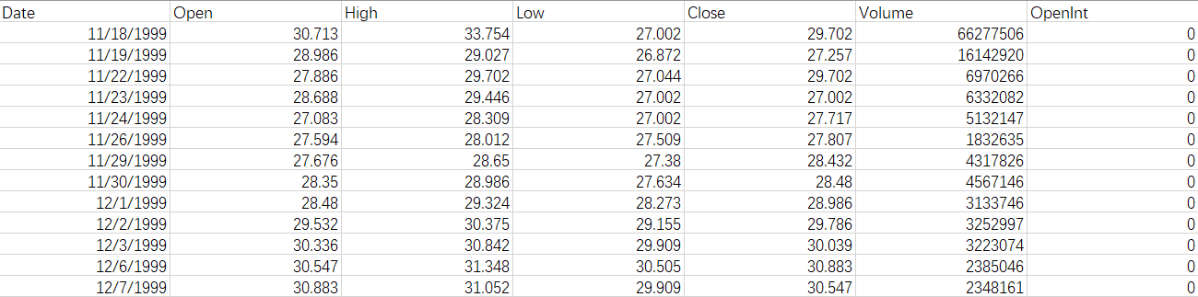
Stock data
Open
High
open, It sets the tone for the day's trading and is often used as a benchmark to measure the day's performance.
High, It indicates the maximum bullish (upward) sentiment during the day. Investors track this to understand the day's price volatility.

Slide 5
low
Close
low, It reflects the maximum bearish (downward) sentiment. It's crucial for understanding the day's price range and volatility.
Close, It's often considered the most important price of the day as it becomes the reference point for the next day's trading. It's used in calculating various financial indicators.

Slide 6
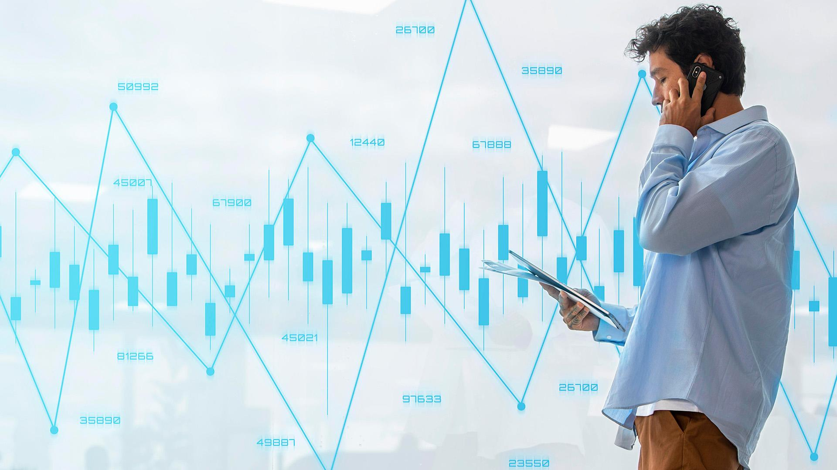
What’s RSI

Slide 7
RSI
Basics
The relative strength index (RSI) is intended to chart the current and historical strength or weakness of a stock or market based on the closing prices of a recent trading period. The indicator should not be confused with relative strength.
Principles
Wilder believed that tops and bottoms are indicated when RSI goes above 70 or drops below 30. Traditionally, RSI readings greater than the 70 level are considered to be in overbought territory, and RSI readings lower than the 30 level are considered to be in oversold territory. In between the 30 and 70 level is considered neutral, with the 50 level a sign of no trend.

Slide 8
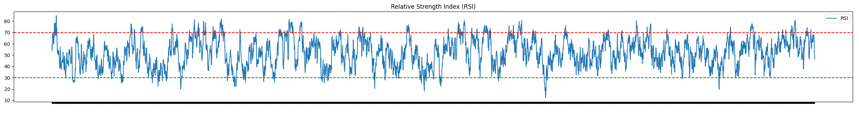
My RSI graph

Slide 9
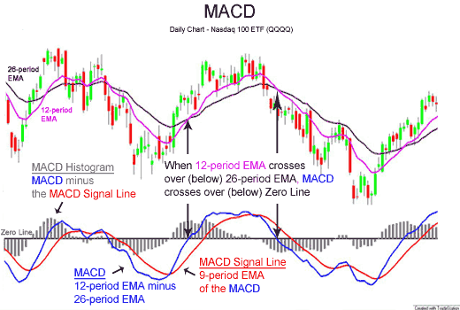
03
MACD

Slide 10
MACD
Basics
MACD, short for moving average convergence/divergence, is a trading indicator used in technical analysis of securities prices, created by Gerald Appel in the late 1970s.[1] It is designed to reveal changes in the strength, direction, momentum, and duration of a trend in a stock's price.
Divergence
If the security’s price diverges from the MACD, it can signal an end to the current trend. For example, if the stock price is rising while the MACD is falling, it could indicate a future downturn in the stock price.

Slide 11
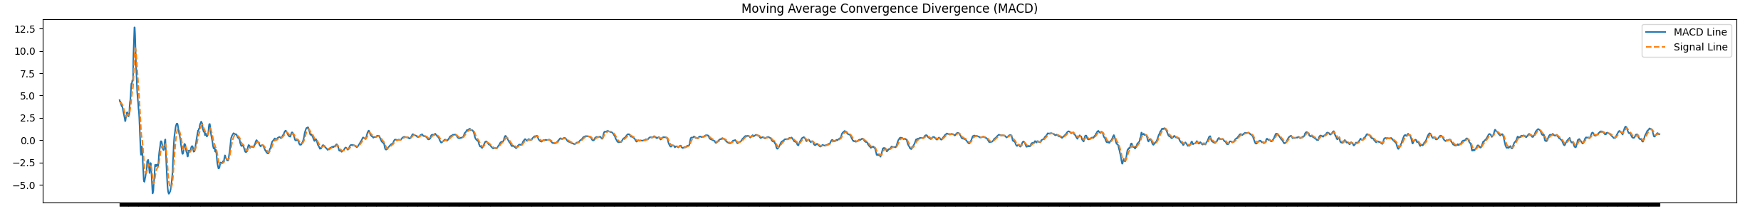
My MACD graph

Slide 12
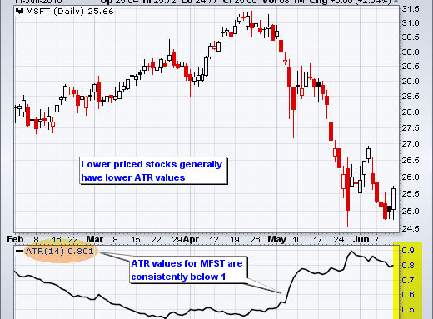
04
ATR

Slide 13
Average true range
Basics
Average true range (ATR) is a technical analysis volatility indicator originally developed by J. Welles Wilder, Jr. for commodities.[1] The indicator does not provide an indication of price trend, simply the degree of price volatility.[2] The average true range is an N-period smoothed moving average (SMMA) of the true range values. Wilder recommended a 14-period smoothing.
Calculation
The true range extends it to yesterday's closing price if it was outside of today's range.
The true range is the largest of the:
Most recent period's high minus the most recent period's low
Absolute value of the most recent period's high minus the previous close
Absolute value of the most recent period's low minus the previous close

Slide 14
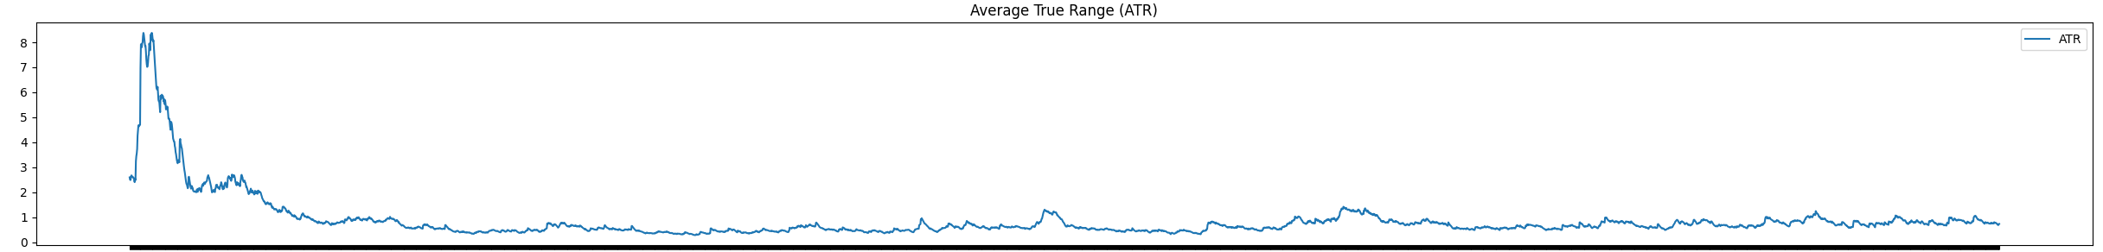
My ATR graph

Slide 15

05
CODE outline

Slide 16

Structrue
start
main
Plot and Analyze
Analyze result
Read and store in stock class
read_stock_data
aligned_dates
Align dates from RSI MACD ATR.
Calculate and return a list
calculate_RSI
calculate_MACD
calculate_ATR
Calculate and return a list
Calculate and return a list

Slide 17
Diffculties
Run time
Align dates
The run time of analyze and plot the final graph is hard to be shorten
Different data has different period of data gathering. To align the dates is hard.
Calculation
Plot
Using for loop to calculate the number and keep track of the date can be hard
Not using any packages is too hard and I must use matplotlib in the end.

Slide 18
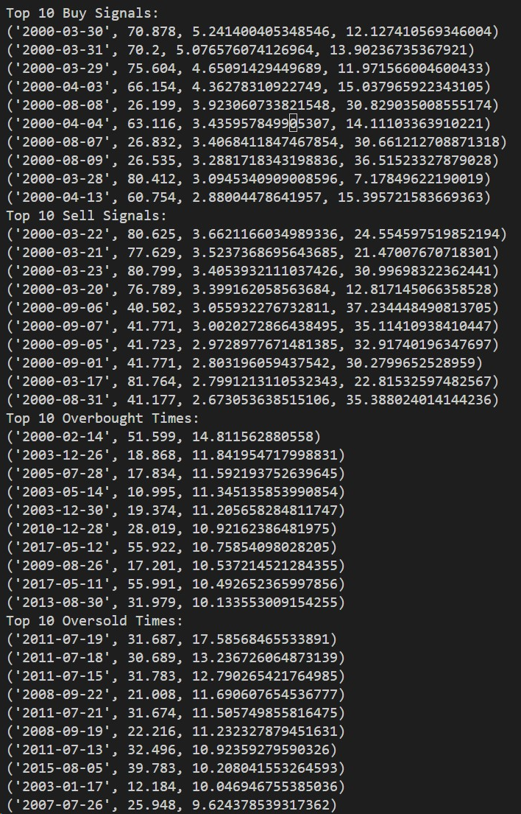
Final result

Slide 19
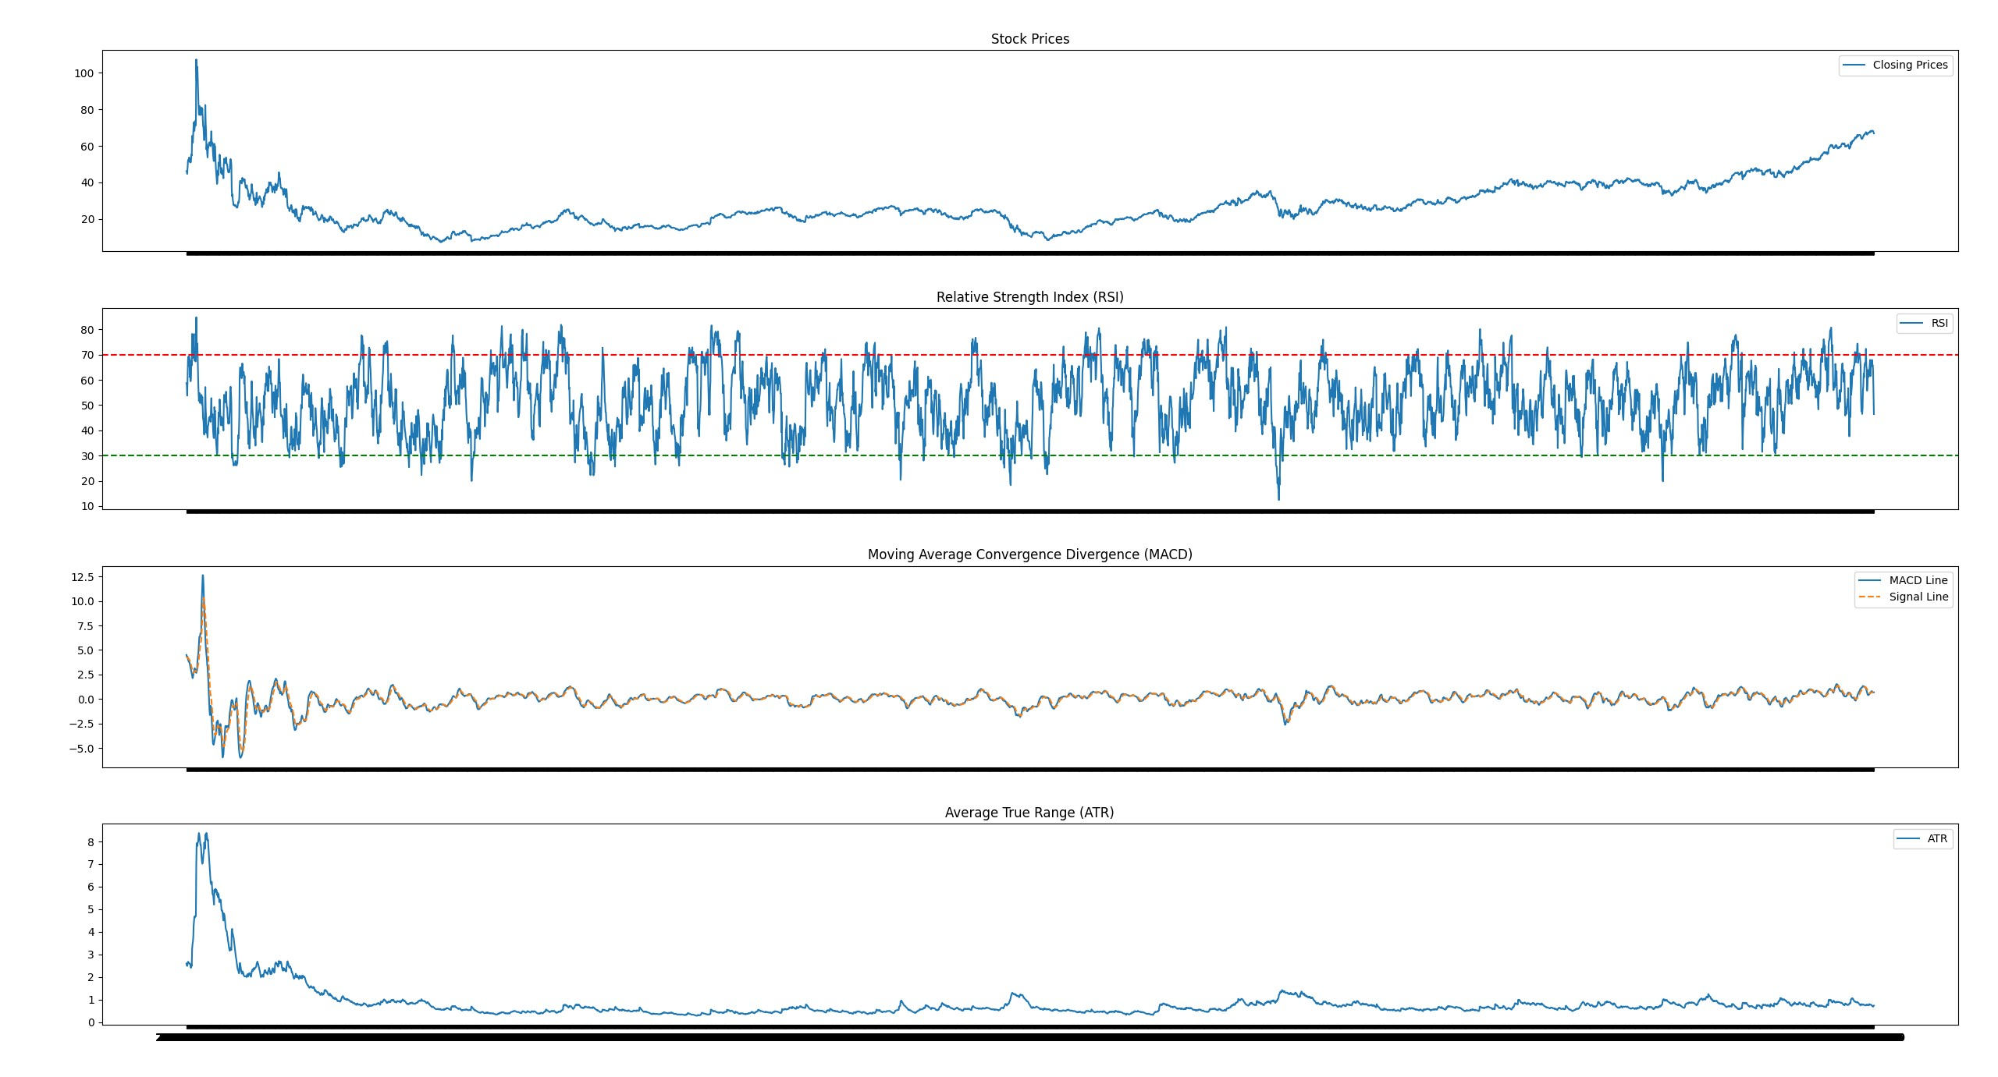
Graph

Slide 20
Thanks!
Please keep this slide for attribution

